Slide 1
Database Fundamentals SQLWithRichard.com
Richard Patlan | M.A.
Database Administrator/Senior SQL Developer
SQLWithRichard.com

Slide 2
Meet Richard Patlan | @SQLRichard
Database Administrator/SQL Developer
Focuses SQL Server Administration and SQL Programming
Present DBA/SQL Developer Chedraui USA
Instructor at UCLA Extension and UCSD Extension
Lecture at Anderson School of Management, UCLA
Industry-recognized consultant:
CoffeeBean
BlackLineSystems
Jafra Cometics
Bloomberg Ribner
More than 30 years of industry experience

Slide 3
Setting expectations
Individuals seeking to learn the fundamentals of relational databases, database management systems, and database components

Slide 4
Course Modules
Database Fundamentals
01 | Introducing core database concepts (50 minutes) Define databases, example of relational database tables, and introduce common database terminology
02 | Relational Concepts (50 minutes) Normalization, referential integrity, and constraints
03 | Creating databases and database objects (50 minutes) Data types, database objects, DDL statements, and creating scripts
04 | Using DML statements (50 minutes) DML statements, using the SELECT statement; using INSERT, UPDATE, and DELETE to manage data; indexes and triggers
05 | SQL Server Administration Fundamentals (50 minutes) SQL Server security; securing database and objects; performing database backups and database restores

Slide 5
01 | Introducing Core Database Concepts
Richard Patlan | M.A.
Database Administrator/Senior SQL Developer
SQLWithRichard.com

Slide 6
Module Overview
Introduce relational databases
Introduce common database components and terms
Discuss the three types of commands used to manage SQL Server

Slide 7
Database Introduction

Slide 8
Database
A database (db) is an organized collection of data, typically stored in electronic format.
It allows you to input, manage, organize, and retrieve data quickly
Traditional databases are organized by records (rows), fields (columns) stored in tables which are stored in the database files

Slide 9
Database
For example, imagine your company maintains a database table with customer information, which contains company data at the account level.
There may also be a different table, which describes all the individual transactions that align to that account.
Together, these tables can provide information about the different industries that purchase a specific software product.

Slide 10
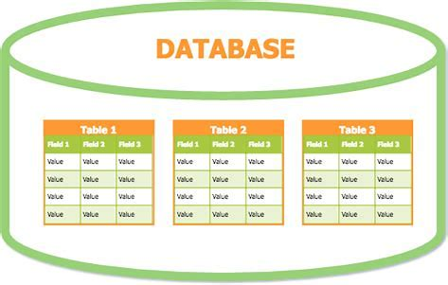
Database

Slide 11
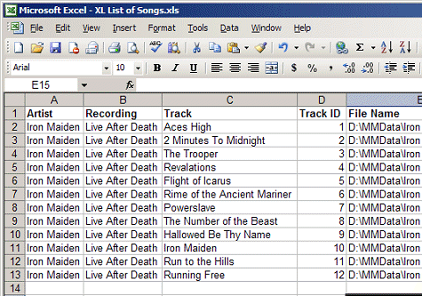
Excel ‘tables’
The idea of a table shouldn’t be new to you if you have used Excel, as that has rows and columns of information and the structure of a SQL Server table is similar to that of an Excel spreadsheet

Slide 12
Tables
A database table is a collection of rows and columns that is used to organize information about a single topic. Each row within a table corresponds to a single record and contains several attributes that describe the row.
These tables are stored in databases
EmployeeID | LastName | FirstName | Department
100 | Smith | Bob | IT
101 | Jones | Susan | Marketing
102 | Adams | John | Finance

Slide 13
Relational databases
A relational database a collection of tables of data all of which are formally described and organized according to the relational model.
Each table must identify a column or group of columns, called the PRIMARY KEY, to uniquely identify each row

Slide 14
Sample relational structure

Slide 15
Common Terms

Slide 16
Database Management System (DBMS)
Database Management System (DBMS) is used by the users to access the data stored in database files. A DBMS is also used to perform administrative tasks on the databases and objects contained within the database.
DBMS is a collection of applications that allows users and other programs to capture and analyze data by providing additional functionality like reporting services to help you create, deploy, and manage reports for your organization.
A RDBMS is a software system designed to allow the definition, creation, querying, and updating of data stored in relational databases.
A few examples of RDBMS include; Microsoft SQL Server, Oracle, DB2, Microsoft Access, and MySQL

Slide 17
Database servers
Databases are stored on database servers which are dedicated physical or virtual servers that host the database files and provide high-level performance for users who are accessing the data.
Database servers contain the DBMS used to manage the data and administer the SQL Server environment.
A database server can have one default instance and several named instances of SQL Server. A SQL Server instance is a copy of the sqlservr.exe program that runs as a Windows operating system service.
Often multiple database servers are deployed to provide high availability and improve performance
This is know as nTier systems

Slide 18
nTier servers
Three-tier architecture is a well-established software application architecture that organizes applications into three logical and physical computing tiers:
the presentation tier, or user interface;
the application tier, where data is processed;
and the data tier, where the data associated with the application is stored and managed.

Slide 19
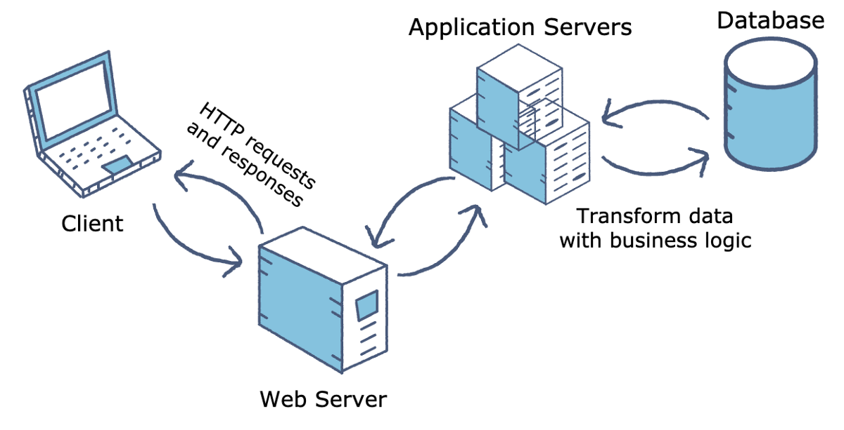
nTier Architecture

Slide 20
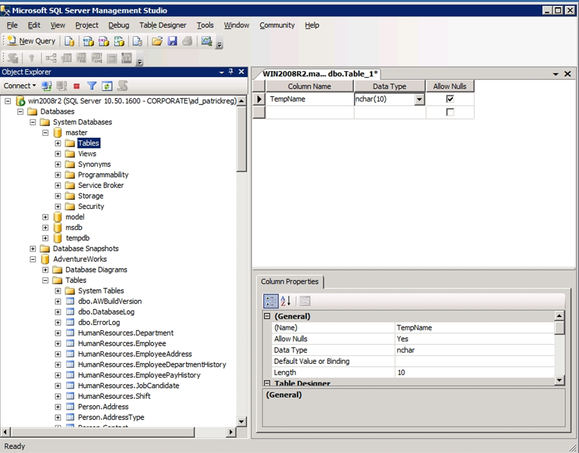
SQL Server Management Studio (SSMS)
A graphical user interface (GUI) used to browse, select, and manage the SQL Server instance and any of the objects within that SQL Server instance.

Slide 21
Exploring SSMS
Demo
Richard Patlan | M.A.
Database Administrator/Senior SQL Developer
dbwebsites.com

Slide 22
Summary
A database (db) is an organized collection of data, typically stored in electronic format.
Microsoft SQL Server, Oracle, DB2 and MySQL are examples of relational databases
DBMS is application used to perform administrative tasks on databases and used to interact with data stored in databases.

Slide 23
Summary
Database server hosts DBMS system and one or more instances of SQL Server
SQL Server Management Studio (SSMS) is the GUI used to manage SQL Server, its databases, and the content contained within the databases
Each RDBMS has its own GUI to manage its databases

Slide 24
Database Fundamentals SQLWithRichard.com
Richard Patlan | M.A.
Database Administrator/Senior SQL Developer
SQLWithRichard.com

