Slide 1
SQL Workshop - 01 SQLWithRichard.com
Richard Patlan | M.A.
Database Administrator/Senior SQL Developer
SQLWithRichard.com

Slide 2
Meet Richard Patlan | @SQLRichard
Database Administrator/SQL Developer
Focuses SQL Server Administration and SQL Programming
Present DBA/SQL Developer Chedraui USA
Instructor at UCLA Extension and UCSD Extension
Lecture at Anderson School of Management, UCLA
Industry-recognized consultant:
CoffeeBean
BlackLineSystems
Jafra Cometics
Bloomberg Ribner
More than 30 years of industry experience

Slide 3
01 |Structured Query Lanaguage (SQL)
Richard Patlan | M.A.
Database Administrator/Senior SQL Developer
SQLWithRichard.com

Slide 4
What is SQL?
The acronym, SQL, stands for Structured Query Language.
It is commonly pronounced as 'Sequel'
SQL is simply pronounced, 'S Q L'. You say each letter individually. It is an acronym, not an abbreviation.

Slide 5
What is SQL?
SQL is not a proprietary language used by specific database vendors. Almost every major DBMS supports SQL
Learning this language will allow you to interact with just about any database.
SQL (Structured Query Language) is a database computer language designed for managing data in relational database management systems (RDBMS).

Slide 6
Data Manipulation Language (DML)

Slide 7
Data Manipulation Language (DML)
The Data Manipulation Language (DML) is the subset of SQL used to add, update and delete data.
The acronym CRUD refers to all of the major functions that need to be implemented in a relational database application to consider it complete.

Slide 8
Data Manipulation Language (DML)
Each letter in the acronym can be mapped to a standard SQL statement:

Slide 9
SQL Basics Operators
Arithmetic Operators (+,-,*,/)
Comparison Operators (=,<>,>,<,>=,<=)
Logical Operators (And, Between, In, Not, Or, Like)

Slide 10
Basics Datatypes

Slide 11
Data Manipulation Language (DML)
This include:
SELECT
UPDATE
DELETE
INSERT
WHERE
and others

Slide 12
SQL Basics
With SQL you:
Insert rows into a database using the SQL INSERT Statement
Update rows in a database using the SQL UPDATE Statement
Delete rows from a database using the SQL DELETE Statement

Slide 13
SQL - INSERT INTO
Insert Data Only in Specified Columns:
Syntax:
INSERT INTO Customers
(cust_number, cust_name
)
VALUES
(
6,'Smith, John'
)
Note! You need at least to include all columns that cannot be NULL.

Slide 14
SQL - UPDATE
The UPDATE statement is used to update existing records in a table.
Syntax:
Update Customers
Set cust_name='Bruin, Joe'
Where cust_id=6

Slide 15
SQL - DELETE
The DELETE statement is used to delete rows in a table.
Syntax:
DELETE FROM Customers
Where cust_id=6

Slide 16
SQL - SELECT
The SELECT statement is probably the most used SQL command.
The SELECT statement is used for retrieving rows from a database and enables the selection of one or many rows or columns from one or many tables in the database.

Slide 17
SQL Basics
With SQL you can:
Retrieve data from a database querying using the SQL SELECT Statement
With SQL, we can query a database and have a result
set returned.

Slide 18
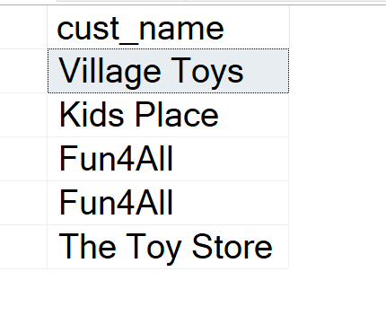
SQL Queries
A query like this returns only column specified:
SELECT
cust_name
FROM
Customers
It returns a result set like this:

Slide 19
SQL - SELECT
This syntax returns all columns because we are using the *:
SELECT
*
FROM
Customers

Slide 20
SQL - SELECT
This simple example gets all the data in the table CUSTOMER.
The symbol “*” is used when you want to get all the columns in the table.

Slide 21
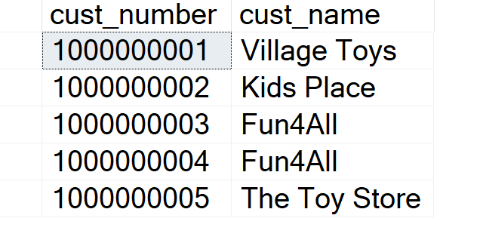
SQL - SELECT
If you only want a few columns, you may specify the names of the columns you want to retrieve, example:
SELECT
cust_number,
cust_name
FROM
Customers

Slide 22
SQL - SELECT
So in the simplest form we can use the SELECT statement as follows:
Select <column_names> from <table_names>
If we want all columns, we use the symbol “*”

Slide 23
SQL - ORDER BY Keyword
If you want the data to appear in a specific order you need to use the “ORDER BY” keywords.
Example:
SELECT
*
FROM
Customers
ORDER BY cust_name

Slide 24
SQL - ORDER BY Keyword
You may also sort by several columns like this:
SELECT *
FROM Customeers
ORDER BY cust_name, cust_city

Slide 25
SQL - ORDER BY Keyword
If you use the “order by” keyword, the default order is ascending (“asc”).
If you want the order to be opposite, i.e., descending, then you need to use the “desc” keyword.

Slide 26
SQL - ORDER BY Keyword
SELECT
*
FROM
Customers
ORDER BY cust_name DESC

Slide 27
SQL - SELECT DISTINCT
In a table, some of the columns may contain duplicate values.
This is not a problem, however, sometimes you will want to list only the different (distinct) values in a table.
The DISTINCT keyword can be used to return only distinct (different) values.

Slide 28
SQL - SELECT DISTINCT
The syntax is as follows:
Select
Distinct <column_names>
From
<table_names>

Slide 29
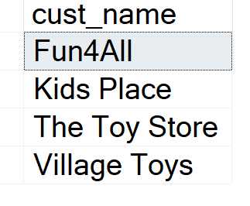
SQL - SELECT DISTINCT
Example:
SELECT
DISTINCT cust_name
FROM
Customers

Slide 30
Data Manipulation Language
Concatenation – Allows you to combine two or more columns
Aliases – allows you to provide an alternate name to a column or table

Slide 31
Data Manipulation Language
String concatenation means to append one string to the end of another string.
Concatenation can be used to join strings from different sources including column values, literal strings, output from user defined functions or scalar sub queries etc.

Slide 32
Data Manipulation Language
SQL Server use the + operator. The example below appends the value in the cust_number column with ' ' and then appends the value from the cust_name column to this.
SQL Concatenation Syntax for Columns:
SELECT cust_number + ' ‘ + cust_name As DisplayName FROM Customers

Slide 33
SQL – Alias
You can give a table or a column another name by using an alias.
This can be a good thing to do if you have very long or complex table names or column names.
An alias name could be anything, but usually it is short.

Slide 34
SQL – Alias
SQL Alias Syntax for Tables:
SELECT column_name
FROM table_name AS alias_name
Example:
SELECT cust_name
FROM Customers AS c

Slide 35
SQL – Alias
SQL Alias Syntax for Columns:
SELECT column_name AS alias_name
FROM table_name
SELECT cust_name AS DisplayName
FROM Customers

Slide 36
SQL - WHERE Clause
The WHERE clause is used to extract only those records that fulfill a specified criterion.
The syntax is as follows:
Select
<column_names>
From
<table_name>
Where
<column_name> operator = value

Slide 37
SQL - WHERE Clause
Syntax:
SELECT
*
FROM
Customers
WHERE cust_id = 5

Slide 38
Table JOINS

Slide 39
JOIN FUNDAMENTALS
By using joins, you can retrieve data from two or more tables based on logical relationships between the tables.
A join condition defines the way two tables are related in a query by:

Slide 40
JOIN FUNDAMENTALS
Specifying the column from each table to be used for the join. A typical join condition specifies a foreign key from one table and its associated key in the other table.
Specifying a logical operator (for example, = or <>,) to be used in comparing values from the columns.

Slide 41
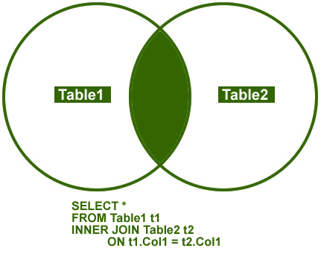
INNER JOIN
This join returns rows when there is at least one match in both the tables.
INNER JOIN option is considered to be the most common join needed in applications and/or queries.

Slide 42
INNER JOIN
This query returns records form Customer, Order and OrderItems tables
SELECT
*
FROM
Customers INNER JOIN Orders
ON Orders.Cust_id = Customers.cust_id
INNER JOIN OrderItems
ON OrderItems.order_id = Orders.order_id
WHERE Customers.cust_id = 4

Slide 43
SQL Workshop -01 SQLWithRichard.com
Richard Patlan | M.A.
Database Administrator/Senior SQL Developer
SQLWithRichard.com

